Slide 1
Predictive modelling on Auto Insurance data
Created by Tania Laha

Slide 2
OBJECTIVE
1) This is an Insurance company data and we are intended to frame a regression model that can give us a regressed prediction of the Customer Lifetime Value (CLV) such that we can predict which of the customers (out of the total customers) are the most profitable ones to this Automobile Insurance firm.
2) Considering this objective, we are running a Linear regression model on CLV, to analyse the influence of several independent factors that affect CLV.

Slide 3
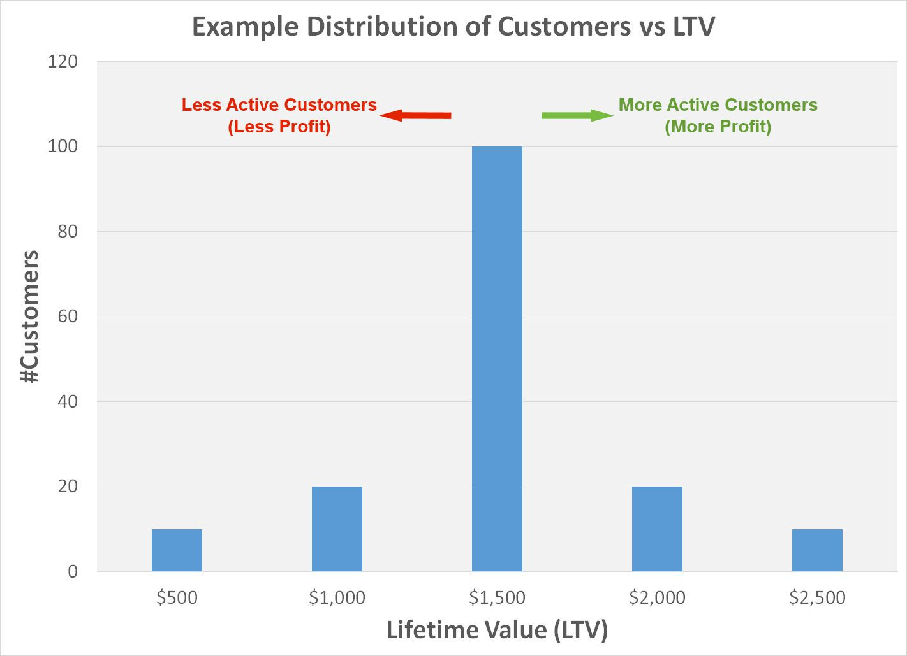
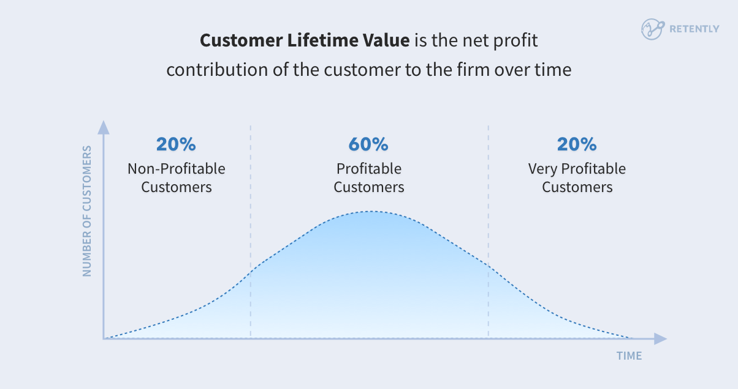
DEPENDENT VARIABLE
Customer Lifetime Value is the target variable which signifies the total revenue the company derives from their entire relationship with the customers.

Slide 4
Count of variables and observations
There are total 23 variables except CLV among which we can reject ‘Customer’ column for our regression model.
We can see there are few continuous variables and rest are categorical columns.
Continuous columns are : "Income", "Monthly Premium Auto", "Months Since Last Claim", "Months Since Policy Inception", "Total Claim Amount“
Categorical columns are: "State","Response","Coverage","Education","Effective To Date", "Employment Status" ,"Gender", "Location Code", "Marital Status" , "Policy Type", "Policy", "Renew Offer Type" ,"Sales Channel","Vehicle Class“ ,"Vehicle Size", "Type of Open Complaints", "Type of Policies"

Slide 5
SIGNIFICANT VARIABLES
From our regression model, we can see significant variables are :
Monthly premium auto
Employment Status
Marital status
Vehicle class
Type of open complaints
Type of policies

Slide 6
Explanation of significant variables
Monthly premium auto : This variable is called as Monthly premium auto which signifies the monthly premiums paid by customers for the auto insurance.
Employment Status : It is the type of profession of each customer. We can see that employed customers can predict CLV more accurately than unemployed ones.
Marital status : Whether a customer is married or not. Single customers have proved to be more reliable in predicting CLV.
Vehicle Class : It is simply the type of vehicles customers are having. From the regression model outcome, we can see ‘Luxury car and SUV’ holders are stronger predictors than other vehicle types.
Type of open complaints : It is the Different types of complaints raised by the customers (0 = 1st type of complaint / 1 = 2nd type of complaint…so on). Type 4 and 5 are potential predictors in our regression model.
Type of policies : Different types of auto insurance policies offered by the company (1 = 1st type of policy / 2 = 2nd type of policy…so on). Type 2,3,4,5,6,7,8 & 9 are most significant predictors among all.

Slide 7
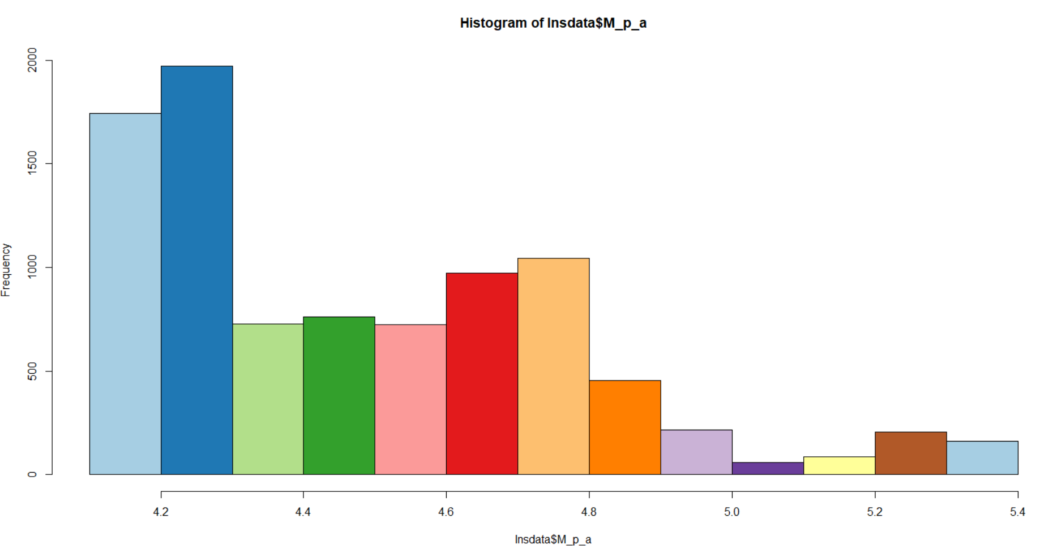
Graphical display of significant variables
Monthly premium auto : Below histogram chart is depicting the occurrences of each value in the column of Monthly premium auto. CLV is strongly dependent on this variable due its ability of effecting the total revenue of an Insurance firm.

Slide 8
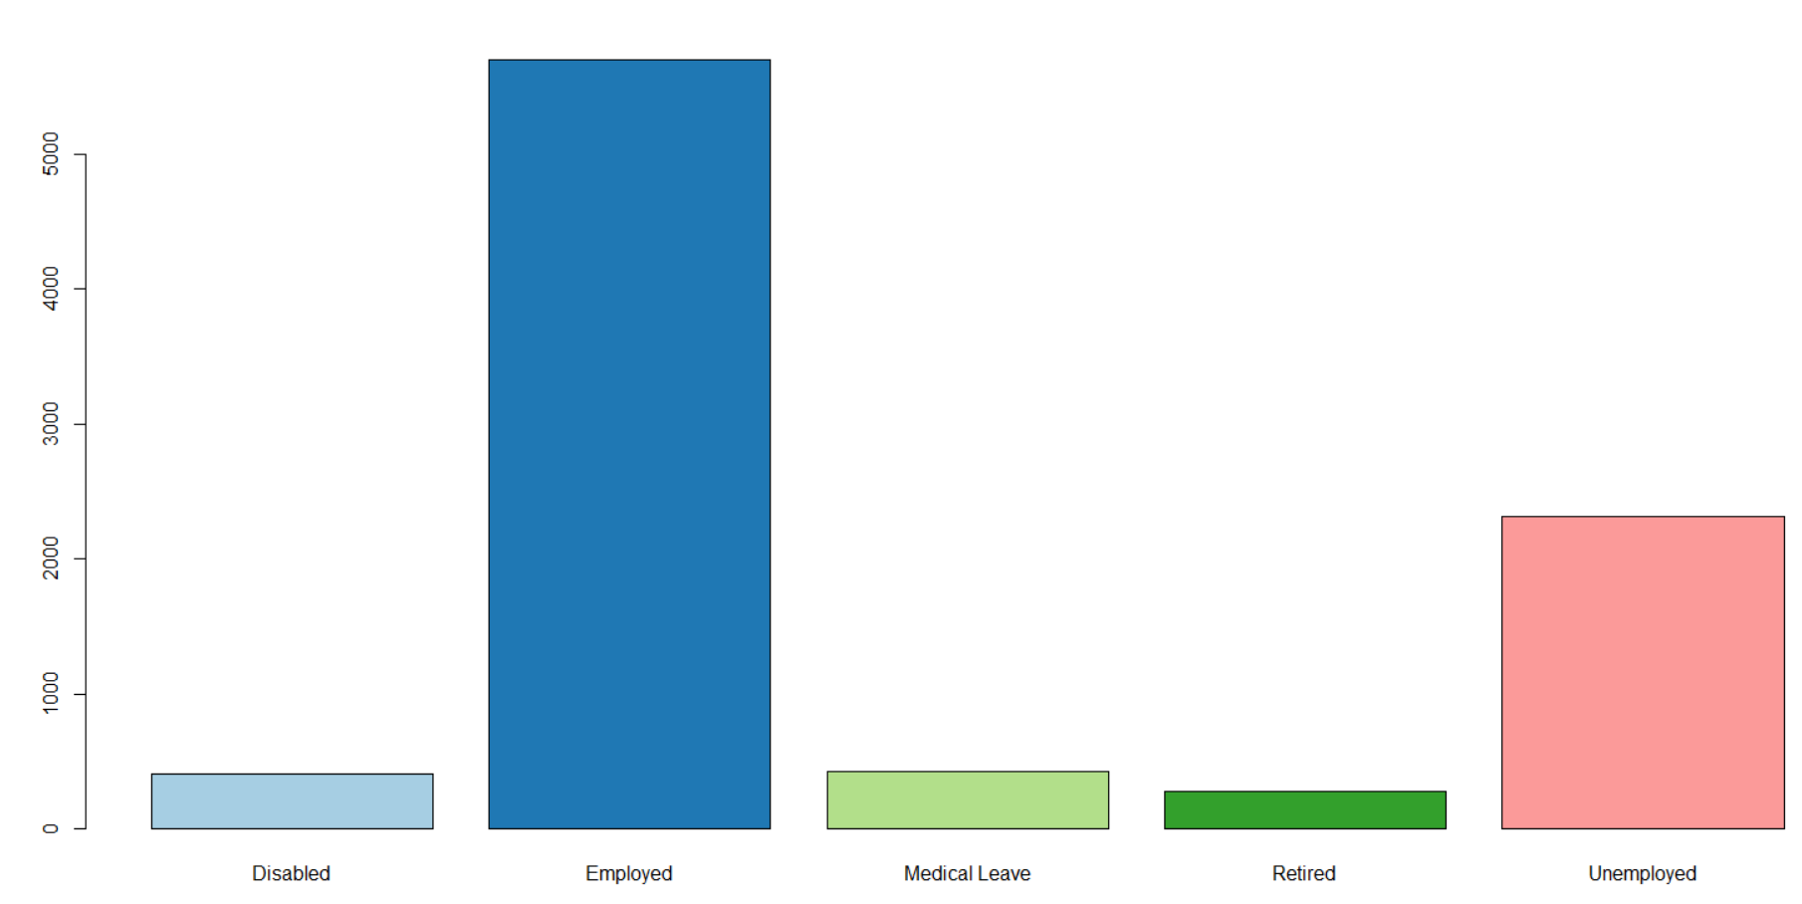
Employment status : This bar plot is created for visualization of Employment status column. It can be inferred from below chart that ‘Employed’ people are having more importance in determining CLV.

Slide 9
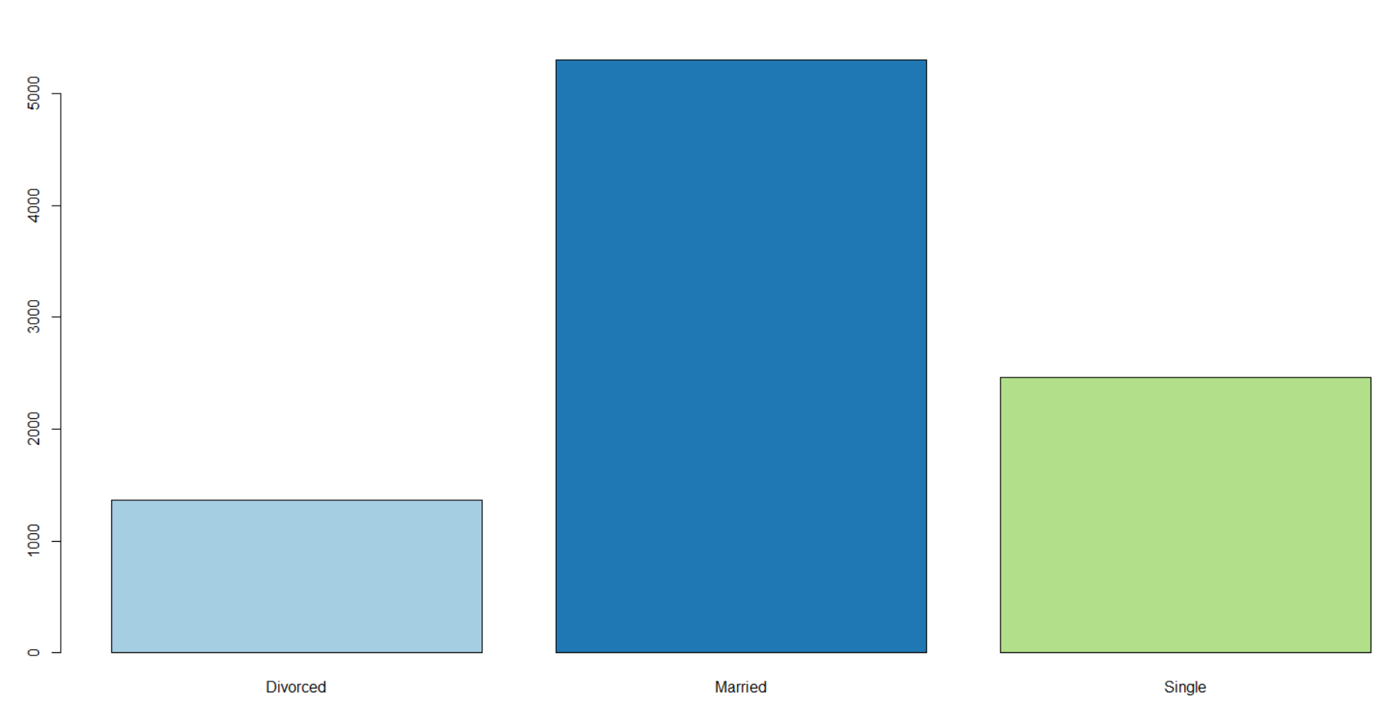
Marital status : Below graph is to describe the ‘Marital status’ column in dataset. This variable is quite significant for prediction of CLV as customers’ preference for buying auto Insurance can change based on their marital status.

Slide 10
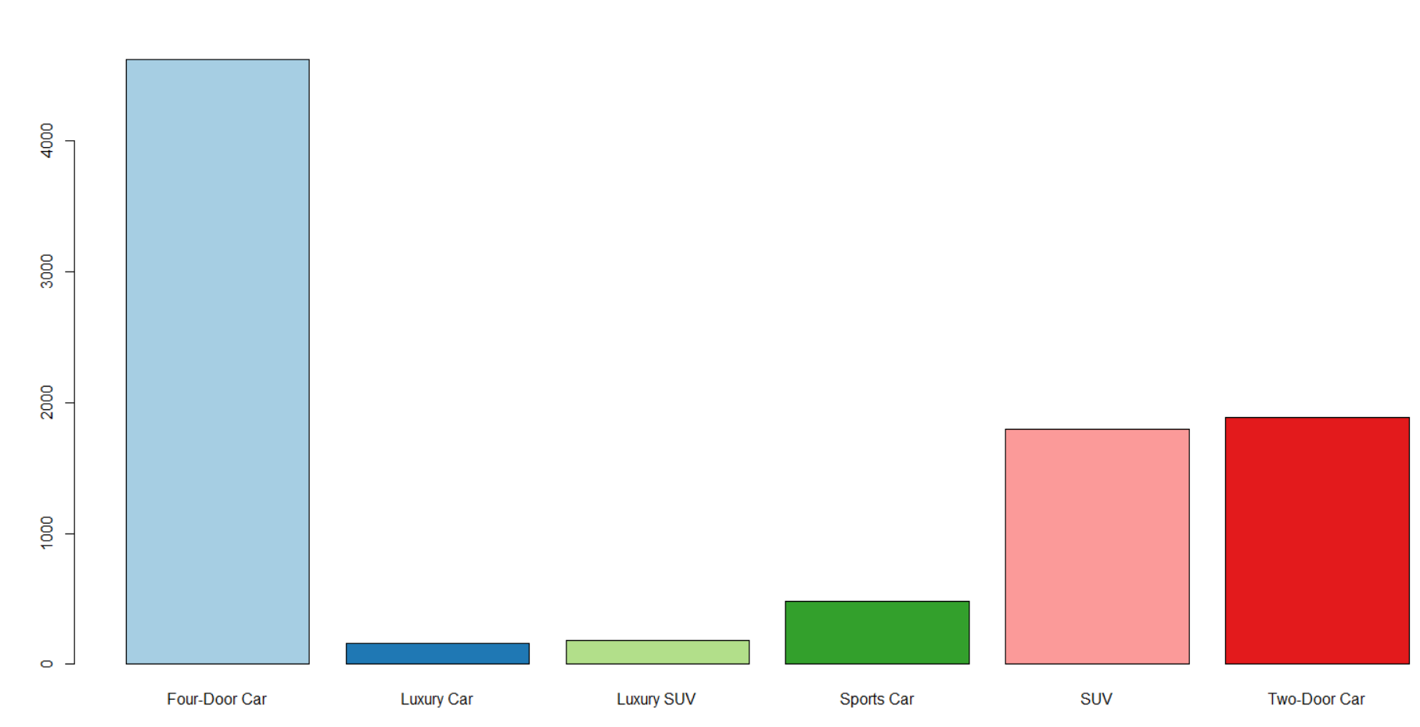
Vehicle Class : The class or type of vehicle is one of the most important factor in prediction of CLV. This variable tells us whether a customer is interested to buy a long-term auto Insurance.

Slide 11
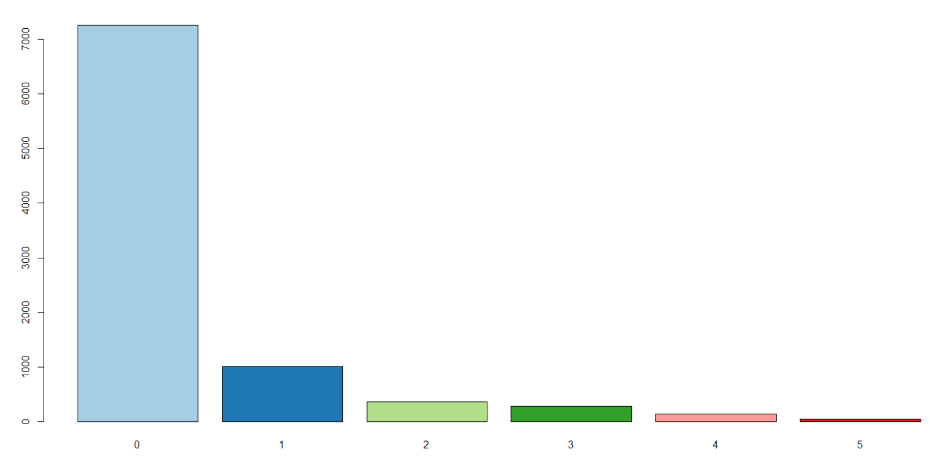
Type of open complaints: Different type of complaints raised by customers against Insurance policies can determine how long a person is willing to maintain relationship and his satisfaction level with this company.

Slide 12
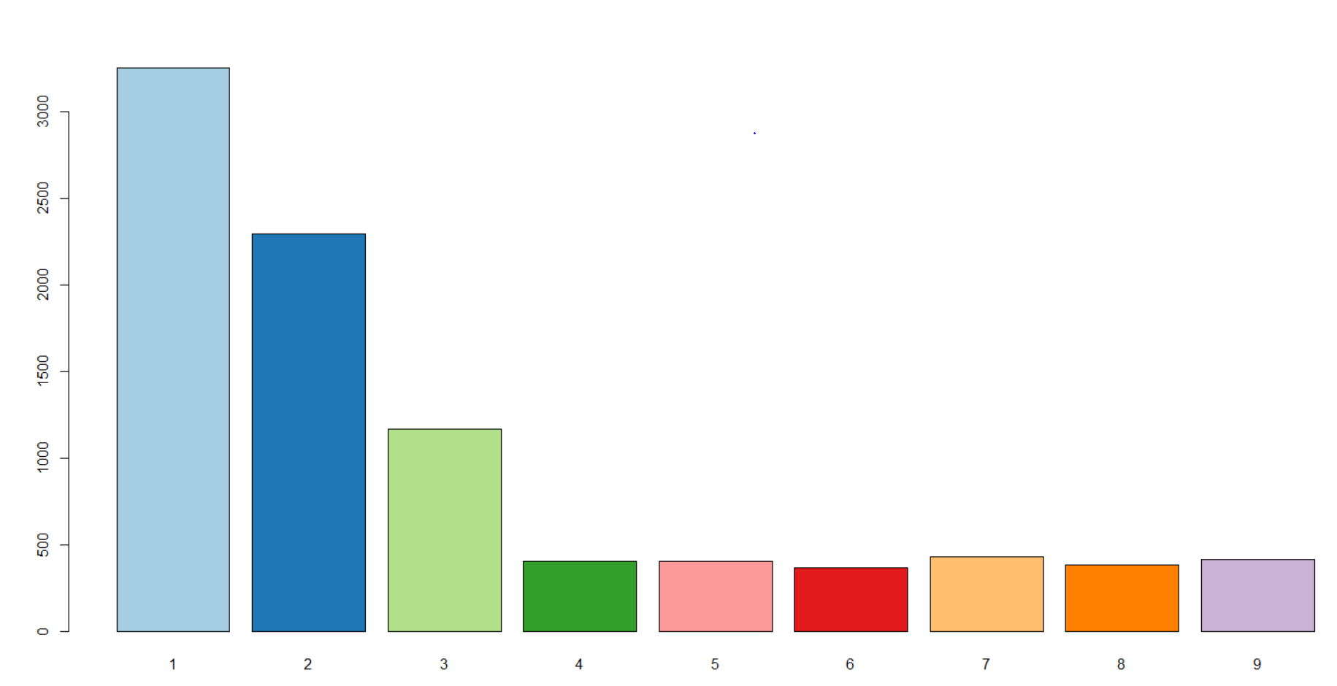
Type of policies : This variable is also one of potential predictor. CLV may vary depending on a policy type offered by Insurance firm to their customers.

Slide 13
RESULTS OBTAINED
It was found from MAPE (Mean and Median error percentage) that our regression model is predicting the outcome 82.88% accurately which signifies this as a pretty good prediction model.
The DW test value has come as : 2.0134 and p-value for this is 0.73. It tells that this model is having no auto correlation i.e. residuals are independent of each other.
The R-square value is found to be 0.634 and adjusted R-square value is 0.6331. As these values are quite higher we can assume this to be efficient predictive model.

Slide 14
Variable relationships
Negative variables : Variables which are having positive relationship with CLV are :
1) Marital Status (Single)
2) Type of Open Complaints (4 &5)
Positive variables : Variables which are having negative relationship with CLV are :
1) Employment status
2) Vehicle Class
3) Type of policies

Slide 15
Business Recommendations
After observing the various variables affecting the CLV, the recommendations that are made to enhance the business are as follows:
Monthly premium is the most significant variable to be taken care
Employed customers should be given highest priority
Persons having ‘Luxury Car’ and ‘Luxury SUV’ are of most important factors.
Policy type 2,3,4,5,6,7,8,9 should be prioritized.
Single, non-married persons can be ignored.
Customers who lodged complaints of type 4 and 5 can be of lowest priority.

